Slide 1
Create, Collaborate and Connect
Digital Skilling with Google Workspace for Education
Google for Education
1

Slide 2
Dr. Rakesh Kumar Gupta, Lecturer
State Council for Educational Research and Training (SCERT), New Delhi, India
2

Slide 3
Create, Collaborate and Connect
Getting Started with Google Workspace for Education.

Slide 4
The need of the hour is...
Establishing 21st Century Learners
Using technology to enable critical thinking
Student to student collaborative learning
Connect their learning to world and develop creativity
Personalized learning for each students with adaptive assessments and engaging content
Digital skilling of teachers to become knowledge workers and deliver blended learning
Ensuring continuity of education amidst crisis (Covid, Climate related shutdowns)
4

Slide 5
Google Workspace for Education Fundamentals
Boost Collaboration
Make it easy and seamless for everyone in your school community to collaborate, communicate, and participate in real time.
Amplify Productivity
Educators can save time by creating, organizing, sharing, and grading coursework all in one place. With a single sign-on, everyone can access all of their files on any device.
Digital Learning on Secure Platform
Rely on best-in-class, multi layered security, with built-in and automated features that simplify security management.
5

Slide 6
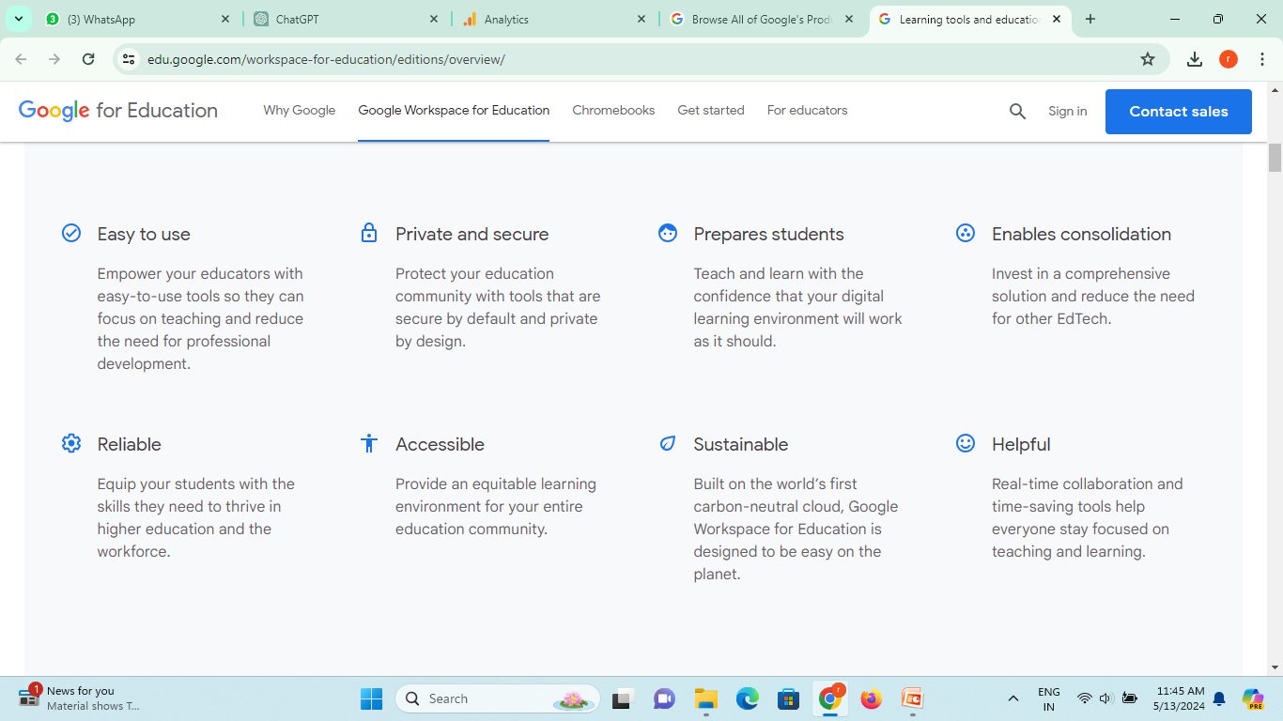
Google Workspace for Education Fundamentals
5

Slide 7
Google Workspace for Education Fundamentals
A free solution for all of your educational needs
More than 170+ million students and educators are using Google Workspace for Education.
Collaborate anywhere
Manage your classroom with ease
Communicate your way
 | Google Drive |  | Google Sheets
 | Google Docs |  | Google Classroom
 | Google Slides |  | Google Meet
 | Google Forms |  | Google Calendar
6

Slide 8
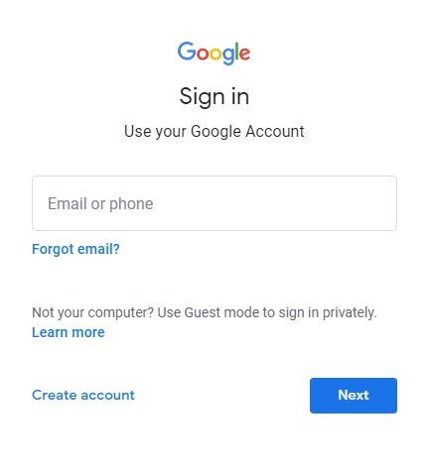
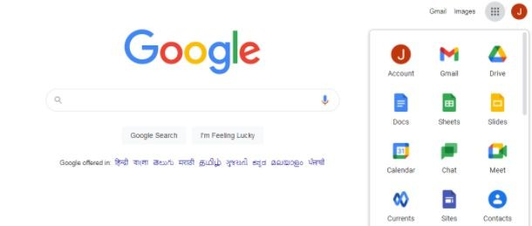
First Step: Login with GMail ID (use your domain ID)

Slide 9
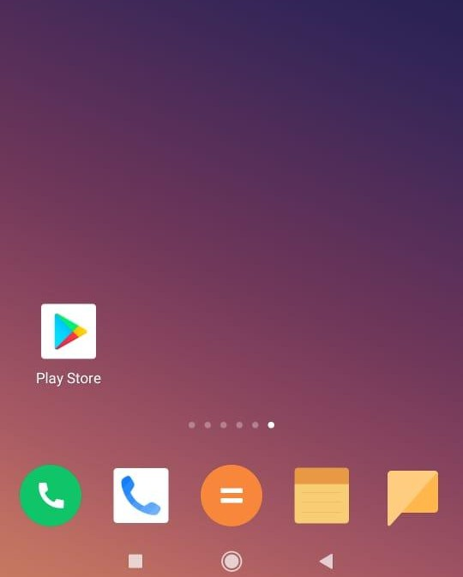
How to download these Google tools in your mobiles?
Go to Play Store or iOS App Store and you can download these free tools-
Chrome
Gmail
Google Meet
Google Drive
Google Docs
Google Slides
Google Sheets
Google Classroom
8

Slide 10
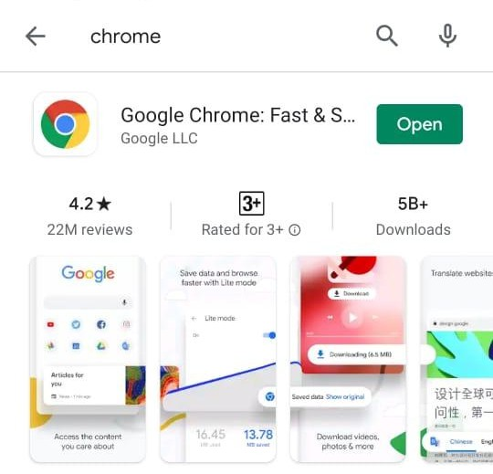
Browser for Mobile Phone
Download Chrome Browser in your mobile phone from Play Store or iOS App Store.

Slide 11
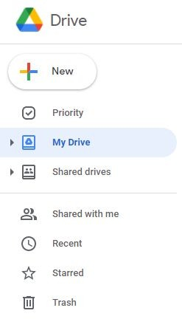
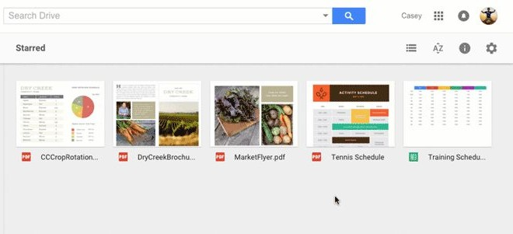
Store Documents
DRIVE is used to keep all the documents in one place.
Rely on ample storage with 100 TB of pooled cloud storage shared by your organization.
You own the documents you create in your Drive and you can share(view,comment, edit rights) with others.

Slide 12
To get to Drive, follow one of these two steps-
Go to app launcher and select the drive icon
Type drive.google.com in address bar

Slide 13
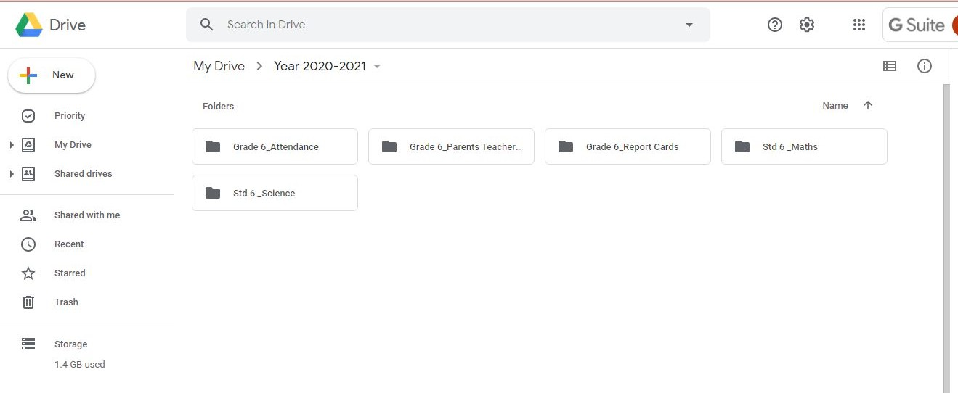
New: Create new Docs, Slides, Sheets, Forms and Drawings. You can upload files from your computer to Drive.
Apps Launcher
Locate your files - MyDrive
Shared with me: Location of files created and owned by someone else. They are granting you access to these files.

Slide 14
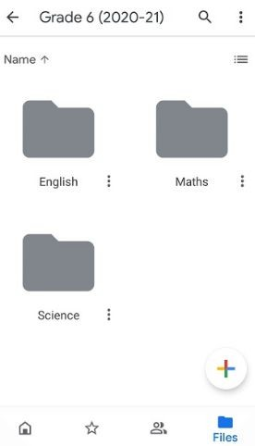
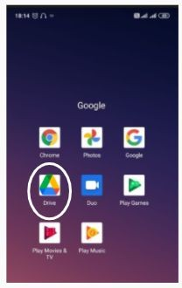
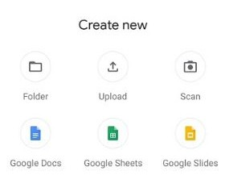
Google Drive in Mobile Phone
Create your folders in Drive and you can upload all the files also from your phone

Slide 15
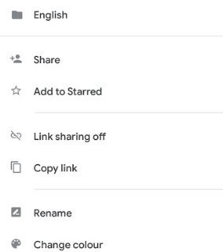
Google Drive in Mobile Phone
To share you folder, click on these three dots and select share and share your files

Slide 16
Types of documents that are created with Drive

Slide 17
Deep Dive into Google Drive

Slide 18
Google Drive Best Practices
Colour Code the Folders
Create Sub Folders and Files within the folder
Use Priority and custom Workspaces to better organize your Google Drive as your work.
“Shared with me” has collection of files shared with you.You may leave them as they are.

Slide 19
Thank you!

